Slide 1

LIBRARY MANAGEMENT SYSTEM
BY:-Rahul Arora​​
ID:- 1911985024

Slide 2
OVERVIEW
• Implementation starts with entering and updating master records like Book Details as well as Library Information.
• Any further transaction like Book Issue; book return will automatically update the current books.
• It will track on the how many books available in library and books issued to the students.

Slide 3
Purpose
• To provide a friendly environment to maintain the details of books and library members.
• To maintain the circulation system using computers and to provide different reports.
• Improved customer service through greater access to accurate information.
• Greater accountability and transparency in operations.

Slide 4
Scope
• Only cover the requirement specifications for the library management system.
• Does not provide any other information except library management system.
• Does not provide any references to the other component of the library management system.
• All the dependencies are also identified in this document.
• Updates the manually library sysyetm into a software based application.

Slide 5
User Characteristics
We have two levels of users
1. User Side:- User will check the availability of the books.
2. Administration Side:- The following are the calibre in the administration side.
- Register user
- Entry book details
- Book issue

Slide 6
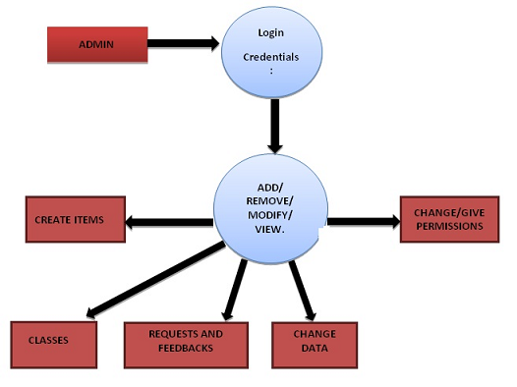
Class Diagram

Slide 7
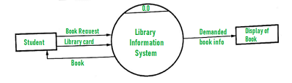
Class Diagram

Slide 8
Requirements
Functional Requirements:
• Book Entry: In this module the book’s information can be store .
• Book Issue: This module is used to keep the track of books issue details.
• Book Return: Also, this module enables to keep a track of returned books.

Slide 9
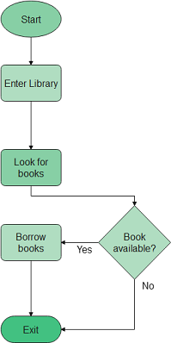
Class Diagram

Slide 10
User Requirements
• Provides good graphical interface for the user.
• Any administrator can operate on the system, performing the required task such as create, update, viewing the details of the book.
• Allow users to view quick reports like book issue/return etc. in between particular time.
• Search facility based on different criteria in depth.

Slide 11
System requirements:
• The system should prompt for the users and administrators to login to the application and for proper input criteria.
Hardware Requirements:
• Operating system: Windows
• Hard disk: 500GB
• RAM: 2GB
• Processor: intel core-i3

Slide 12
Technology used
MongoDB - Document database - to store data
Express.js - Back-end web application framework running on top of Node.js
React - Front-end web app framework
Node.js - JavaScript runtime environment

Slide 13
Non Functional Requirements
• Safety requirements: The database may get crashed at any certain time due to virus or Operating system failure. Therefore, It is required to take the database backup.
• Security Requirements: Access rights are decided to prevent from unauthorized access.
• Hardware Constraints: The system requires a database in order to store the persistent data. The database should have backup capabilities .

Slide 14
Screenshots:

Slide 15
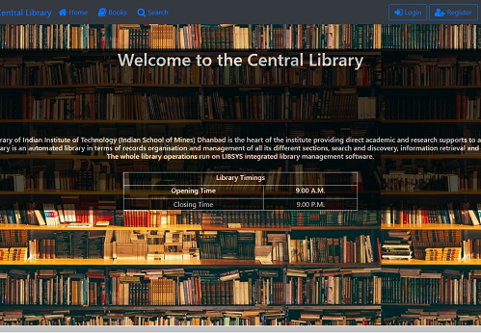
Home Page:

Slide 16
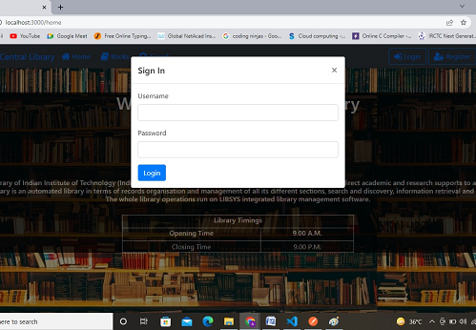
Login Page:

Slide 17
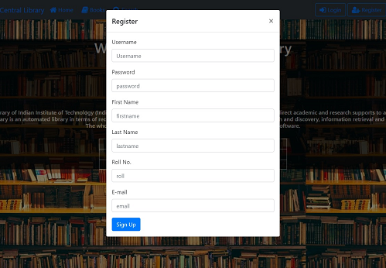
Registeration Page:

Slide 18
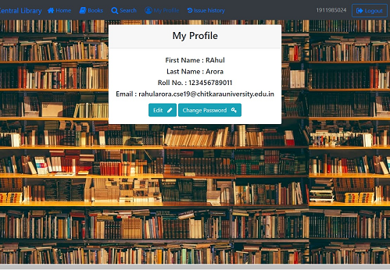
Profile Page:

Slide 19
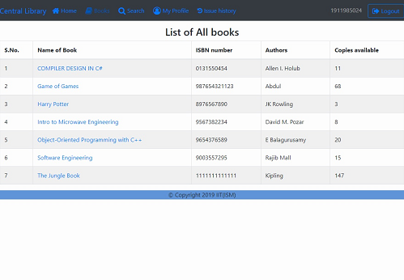
Book Page:

Slide 20
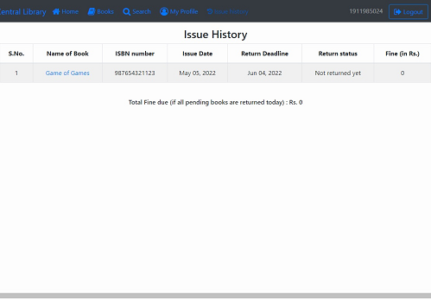
Book Issue Page:

Slide 21
Conclusion
• It will take care of the current book detail at any point of time.
• The book issue, book return will update the current book details automatically show that user will get the update current book details.
• The main purpose of this project is to reduce the manual work.
• This software is capable of managing book issue & book return.

Slide 22
Special Thanks
Mr.Mukesh Kumar Jangid Sir
&
Mr.Mananjay Dubey Sir

